Slide 1
WELCOME

Slide 2
MYSORE PALACE
Mini project
on
Computer Graphics and Visualization
Presented By:
ABHISHEK T 4SM17CS002
ARPITHA M 4SM17CS011
Under the Guidance of :
Mrs.MKSHRUTHI M.Tech Mr.PRAVEEN S M.Tech,MISTE,(Ph.D.)
Asso.Prof,Dept of CS&E, Asso.Prof,Dept of CS&E,
SJMIT,Chitradurga. SJMIT,Chitradurga.

Slide 3
Contents:
Introduction
Abstract
Aim of the project
Object Description
Requirements Specification
Snapshot
Output screen
Conclusion
References

Slide 4
INTRODUCTION:
Computer Graphics is a complex and diversified technology. To understand the technology it is necessary to subdivide it into manageable parts. This can be accomplished by considering that the end product of computer graphics is a picture. The picture may, of course, be used for a large variety of purpose; e.g., it may be an engineering drawing, an architectural rendering for a proposed construction or design project, or a single frame from an animated movie. The picture is the fundamental cohesive concept in computer graphics

Slide 5
Abstract:
MYSORE PALACE is 2D representation of a palace which shows the person standing in front of the palace and shows the sun rising and sunset where the links from one screen to another screen is given through the mouse it is easy to use and has a graphical user interface and In this Computer graphics it is concerned with all the aspects of producing pictures or images using computer.We can model all the real world objects, render them, give various material properties for them and create animations using computer graphics
Computer graphics is largely interactive, the user controls :
The contents of the object.
Structure of the object.
Appearance of the object

Slide 6
Aim of thE project:
The aim of the project is to graphically represent an visiting a Mysuru palace.
To make a 2D representation of a Palace.
To simulate people looking at the Palace.
To person standing on the footpath.
Moving of sun.

Slide 7
system specification:
Hardware Requirements
Processor : Intel Pentium 4 CPU & higher versions
RAM : 256 MB and higher
Hard Disk : 80GB
Mouse : 3 Button Mouse or Track pad
Keyboard : QWERTY Keyboard
Monitor : Standard VGA
Software Requirements:
Programming Language : C/C++ using OpenGL
Operating System : Windows /Linux OS
Compiler : Code blocks/ C Compiler
Graphics Library : GL/glut.OpenGL 3.0

Slide 8
SNAPSHOTS

Slide 9
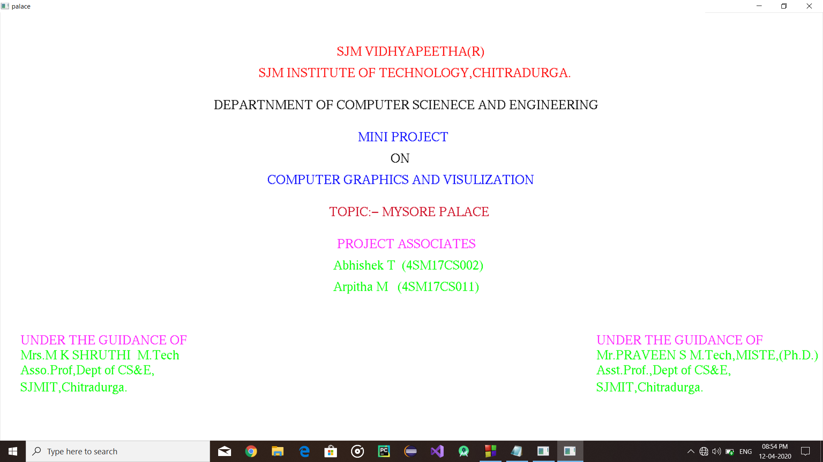
Front Screen

Slide 10
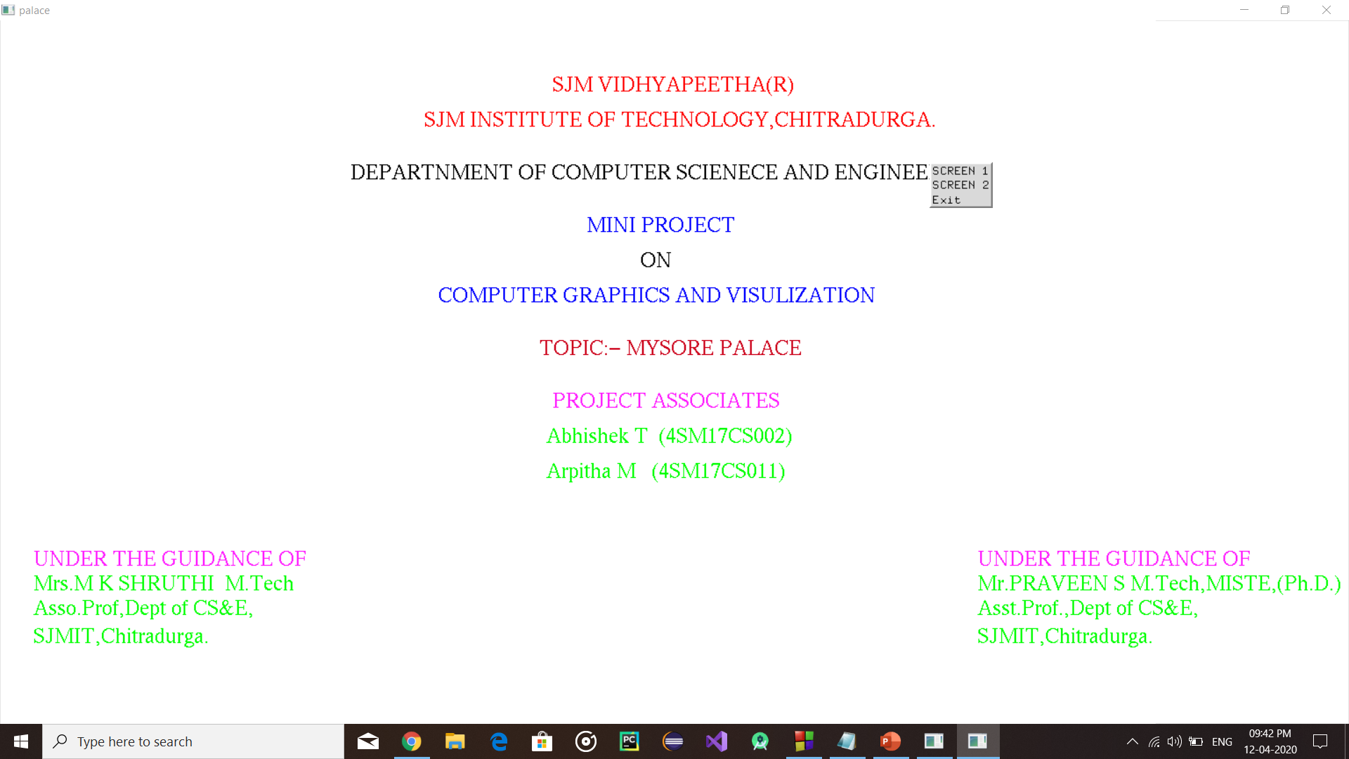
Front MENU Screen

Slide 11
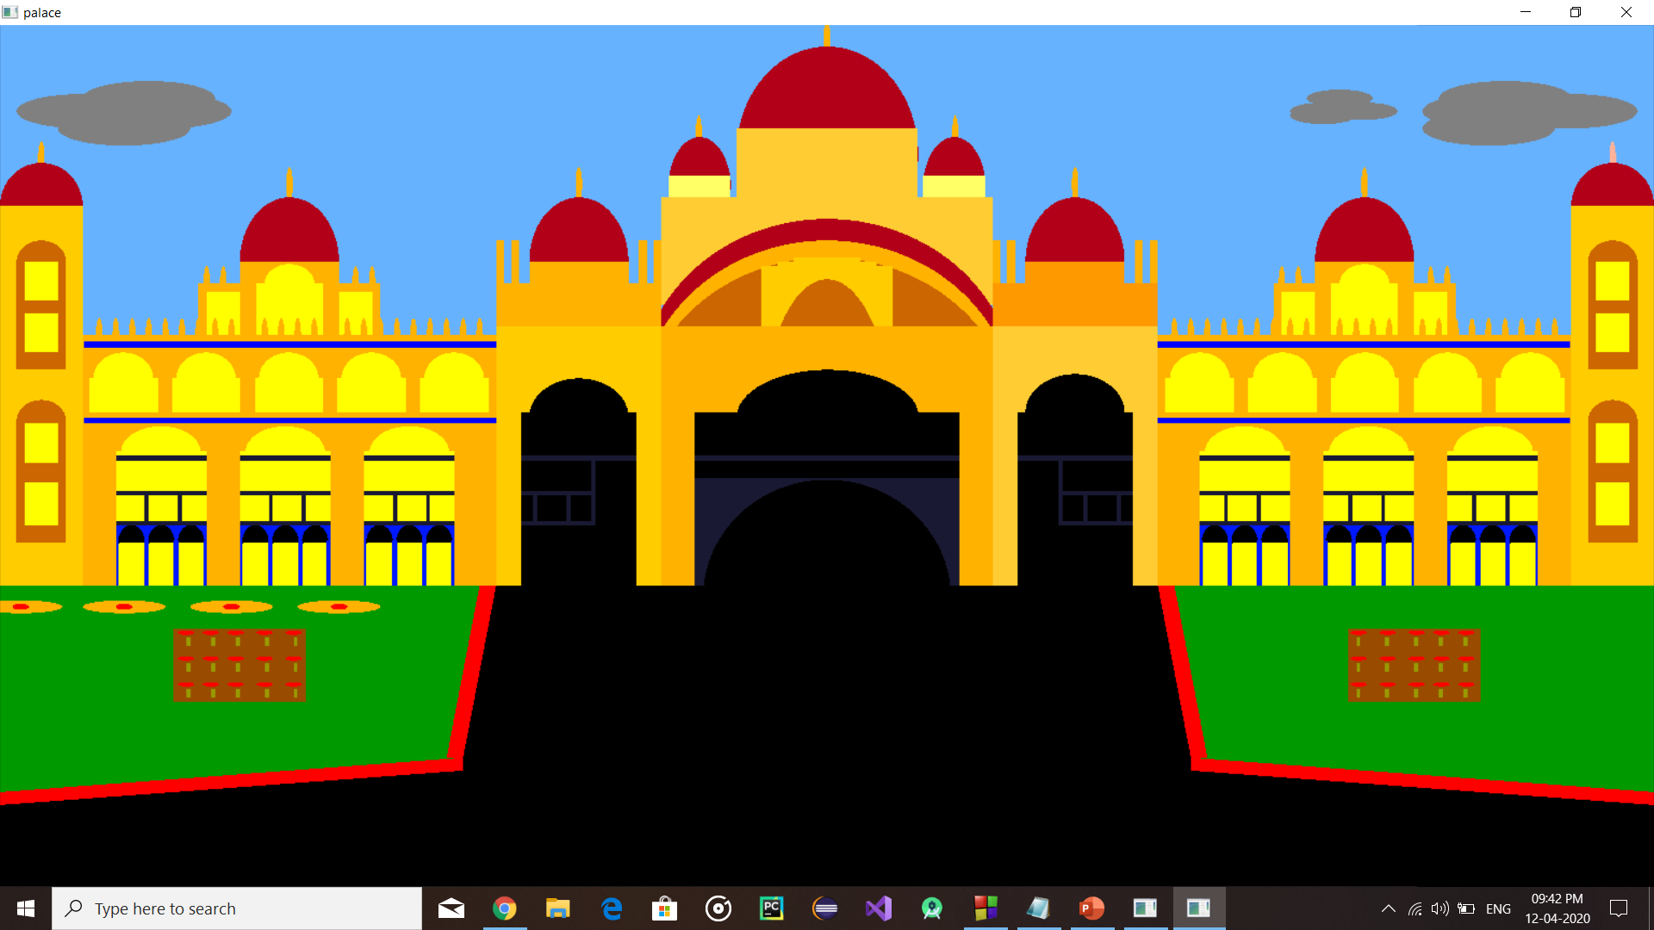
Mysore palace

Slide 12
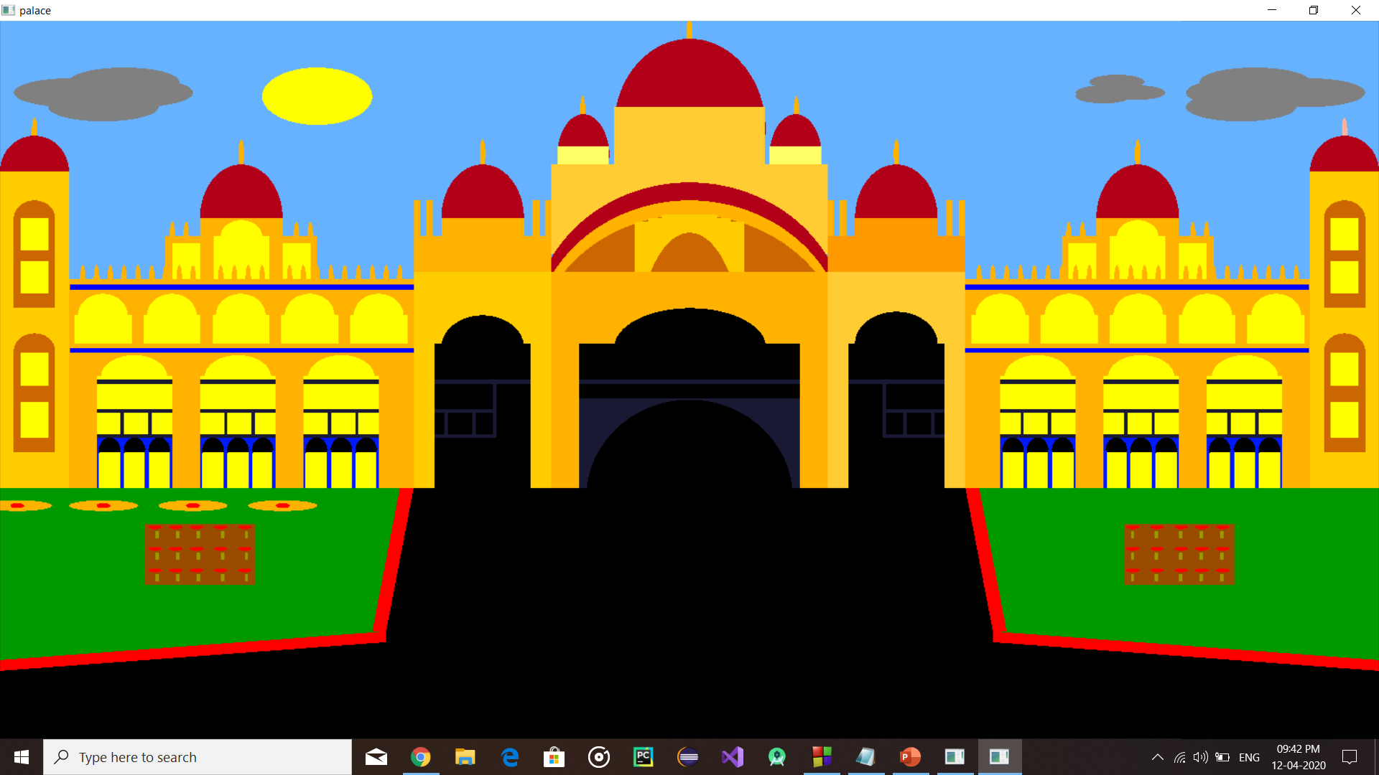
Front palace sun rise

Slide 13
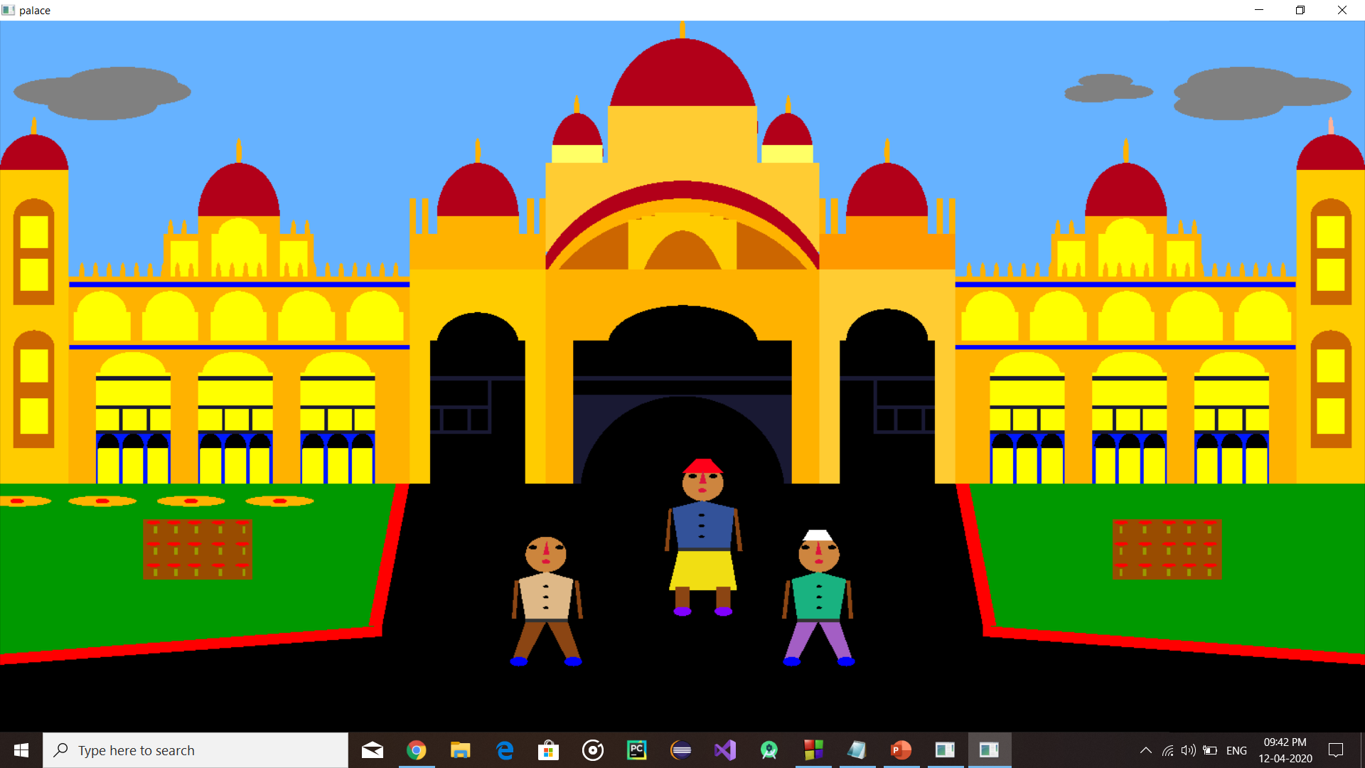
Visitors visiting Mysore palace

Slide 14
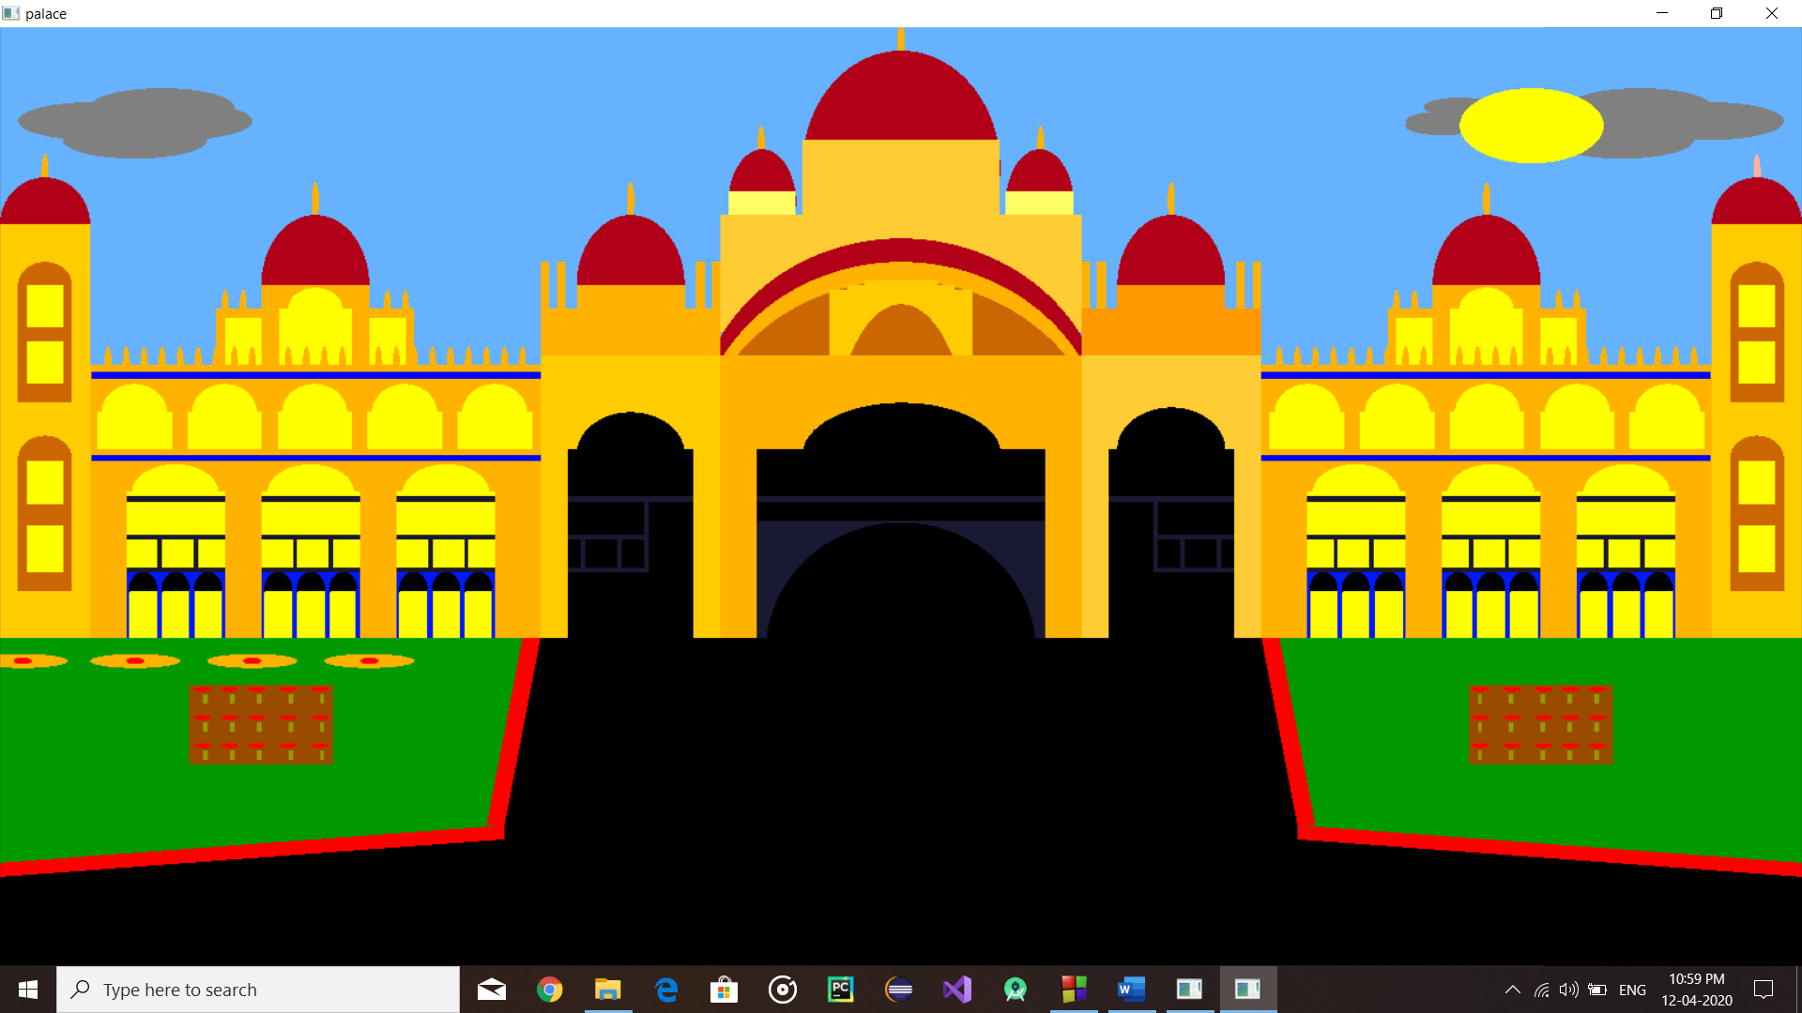
Sun movement

Slide 15
conclusion:
Here we conclude that using OpenGL any form of images, designs and animations can be produced and also we can give realistic effects to it like in our project.
In OpenGL, we get smooth surface to draw the objects and we have provided texture and color effect to the objects.

Slide 16
reference:
openGL programming guide, 8th edition.
Interactive computer graphics by Edward angel, 5th edition.\
Http://www.openGL.com
Http://www.Codeincodeblocks.Com
Http://www.Opengl.Com/forum/
Http://www.Stackoverflow.Com

Slide 17
Thank You

